Slide 1
Autonomous Smart Parking System (ASPS)
IBM Naan Mudhalvan-Group 2
Internet Of Things(IOT)
5113: Kingston Engineering College
By:
Naveen Moses D | au511321106017 | naveenmosesdinesh@gmail.com
Karthick V | au511321106014 | karthicksparrow201@gmail.com
T.N.Uthrakumar | autle-02ece | uthrakumar608@gmail.com
Sanjay Kumar S | au511321106020 | sanjaysivakumar0910@gmail.com

Slide 2
CONTENTS
SLOT ALLOCATION AND BOOKING
Flow chart
Components & Circuit Diagram
Coding
AUTOMATIC PARKING
Flow chart
Components & Circuit Diagram
Coding
BLINK
Introduction
Flow chart
Work Flow

Slide 3
01
SLOT ALLOCATION AND BOOKING

Slide 4
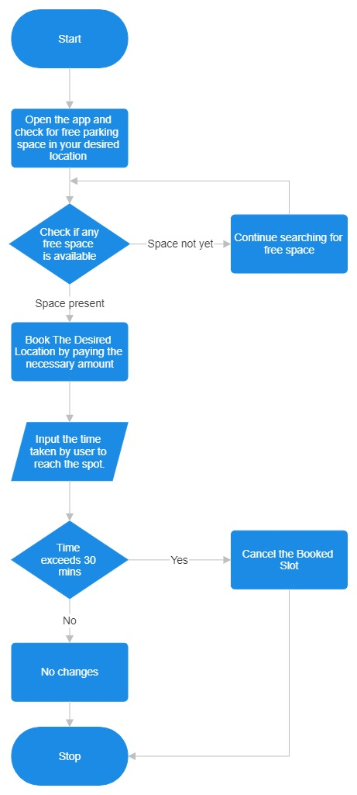
WORKING FLOW CHART

Slide 5
User Registration
Users need to register and create an account in the smart parking system's mobile app or website.
Finding Available Parking Slots
Users can check the availability of parking slots in real-time through the app or website.
The system should provide information about the location, number of available slots, and pricing.
Selecting a Parking Slot
Users can select an available parking slot based on their preferences, such as proximity to their destination or budget.
Booking a Slot
Once a user selects a parking slot, they can proceed to book it.
The system should allow users to choose the place and slot.

Slide 6
Payment
Users need to make a payment for the reserved parking slot. This can be done through various payment methods, such as credit/debit cards, mobile wallets, or prepaid parking credits
Confirmation
After a successful payment, users should receive a confirmation with details of their booking, including a QR code or booking ID.
Entry and Exit
To access the parking facility, users can scan the QR code or present the booking ID at the entry gate.
The system should track entry and exit times to calculate the parking duration.
Extensions and Cancellations
Users may have the option to extend their parking duration if needed, provided there are available slots.
Cancellation policies should be in place, allowing users to cancel their bookings with a refund if they change their plans.

Slide 7
Real-time Updates
The system should continuously update slot availability in real-time to account for cancellations or early departures.
Notifications
Users can receive notifications reminding them of their upcoming booking or when their parking time is about to expire.
Overstay Alerts
Users should be notified if they exceed their booked parking time, and additional charges may apply.
Reporting and Analytics
The smart parking system can generate reports and analytics to help parking facility managers optimize slot allocation, pricing, and overall operations.

Slide 8
Integration with Navigation
Integration with navigation apps can provide users with directions to their reserved parking spot within the facility.
Security
The system should ensure the security of user data and payment information.

Slide 9
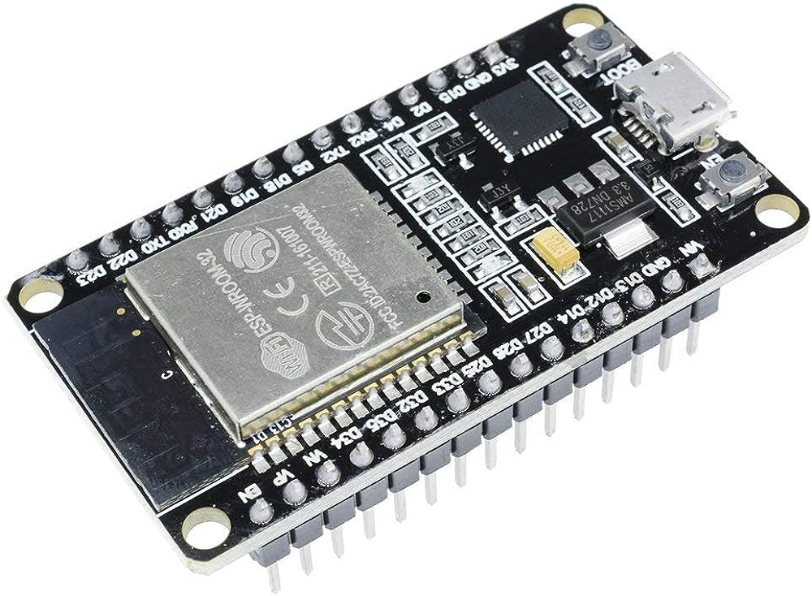
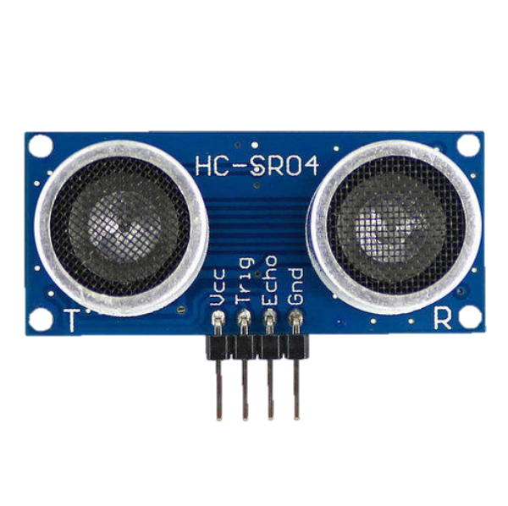
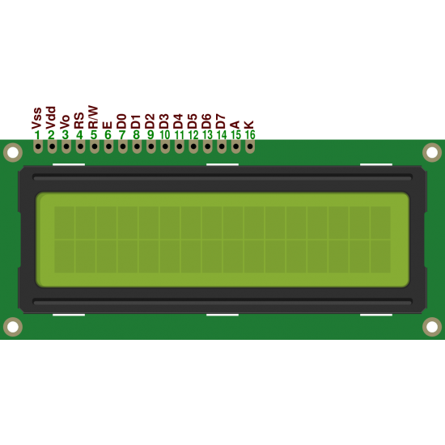
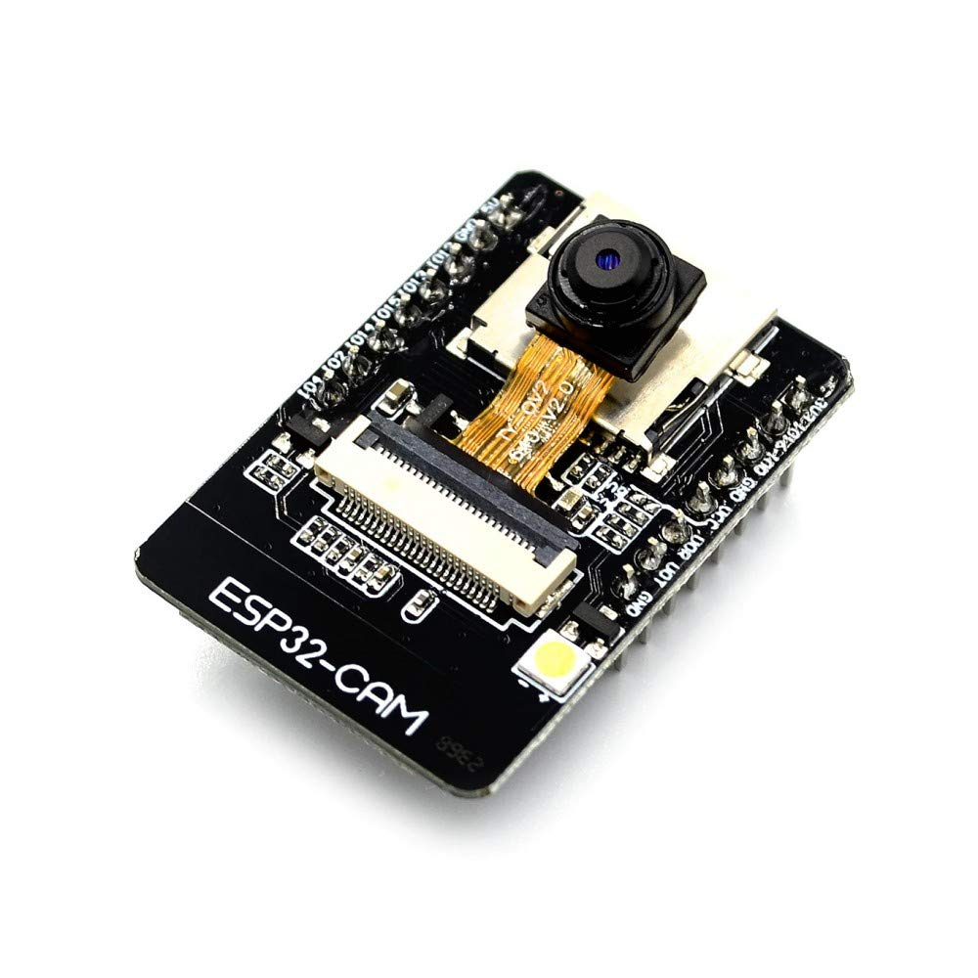
Components
ESP 32
ULTRASONIC SENSOR
16 x 2 LCD display
Camera Module

Slide 10
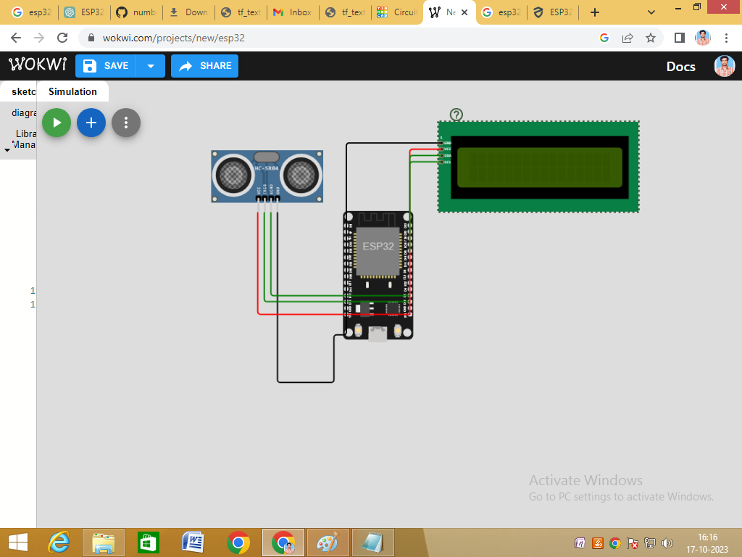
CIRCUIT DIAGRAM

Slide 11
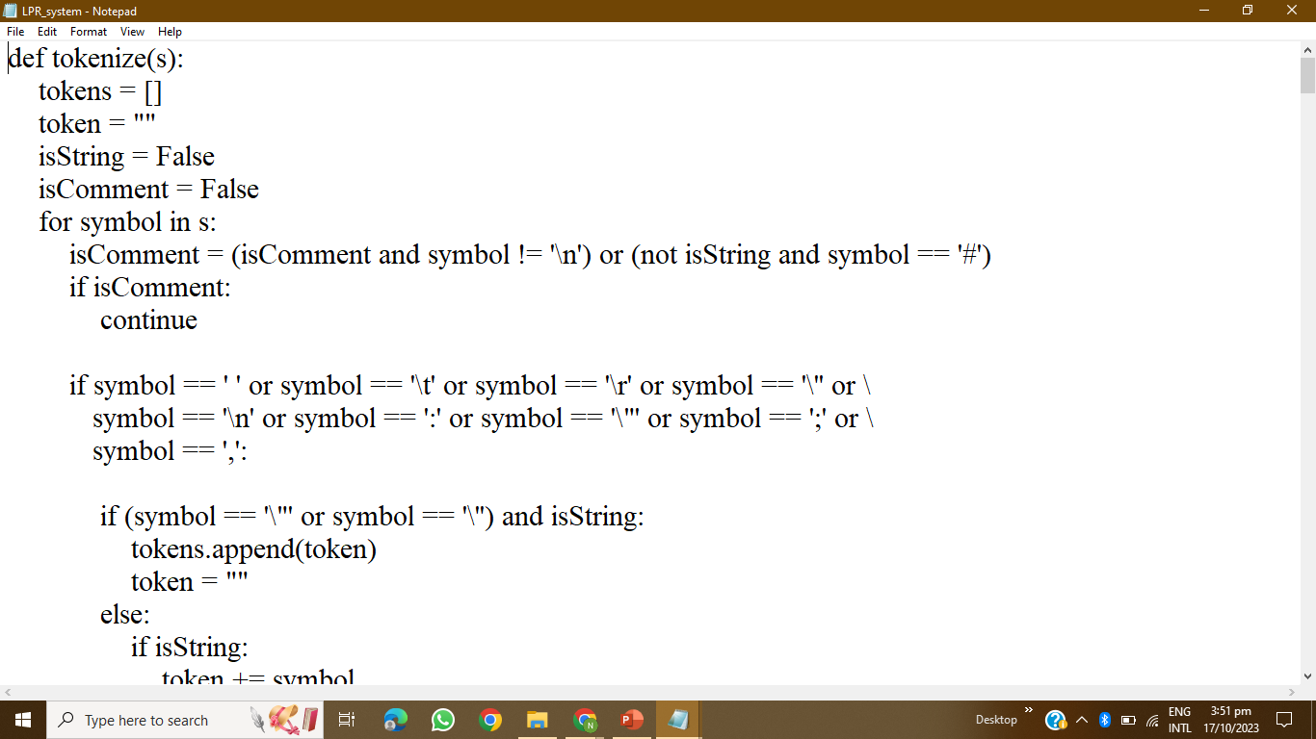
CODING

Slide 12
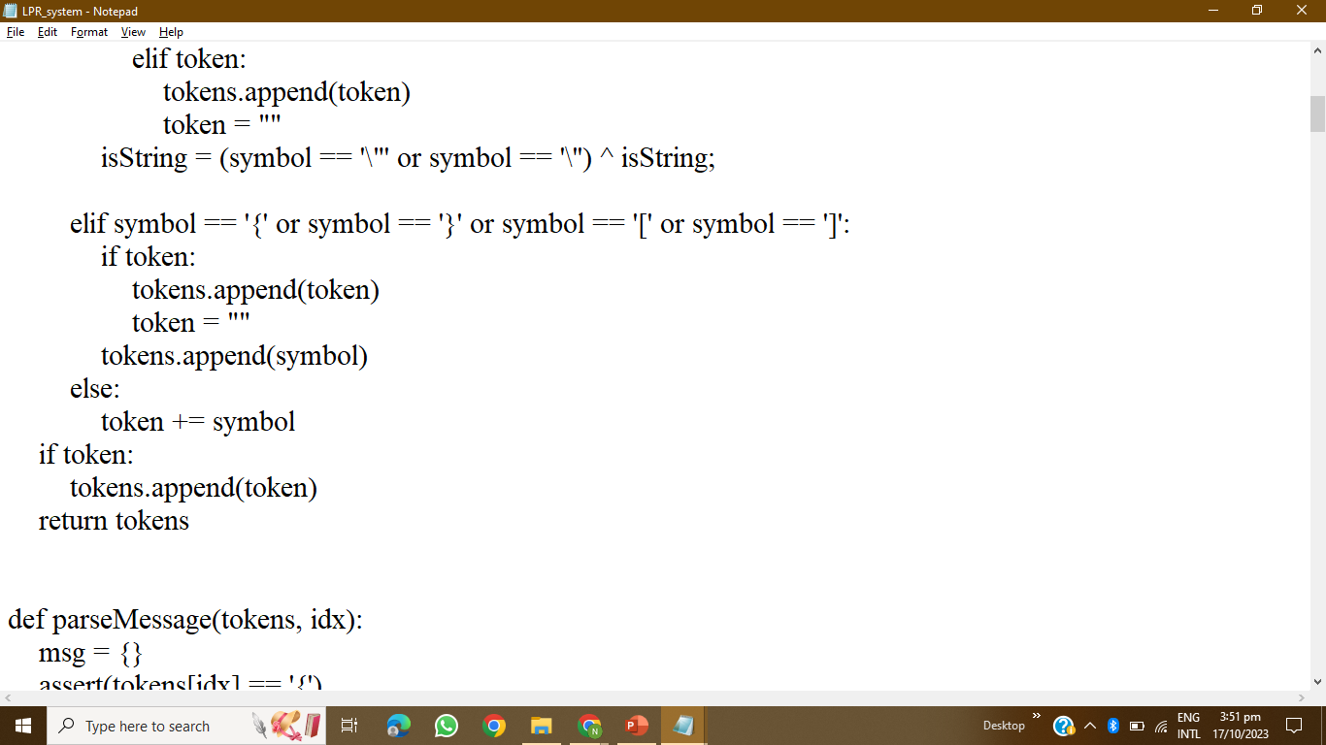
CODING

Slide 13
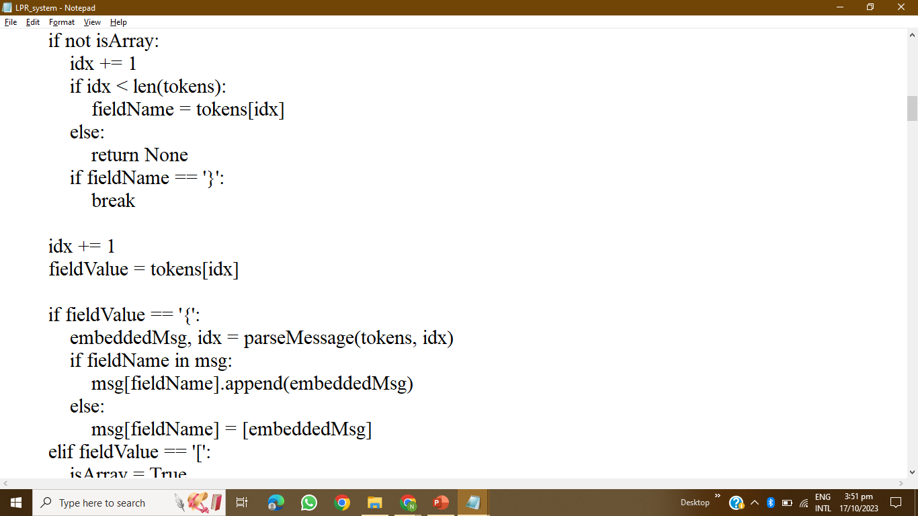
CODING

Slide 14
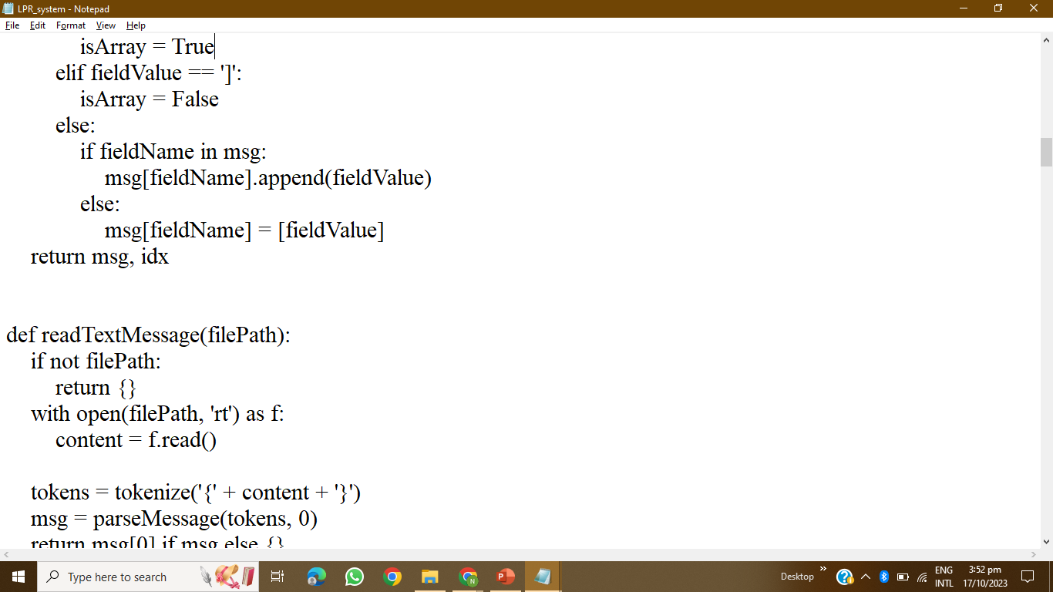
CODING

Slide 15
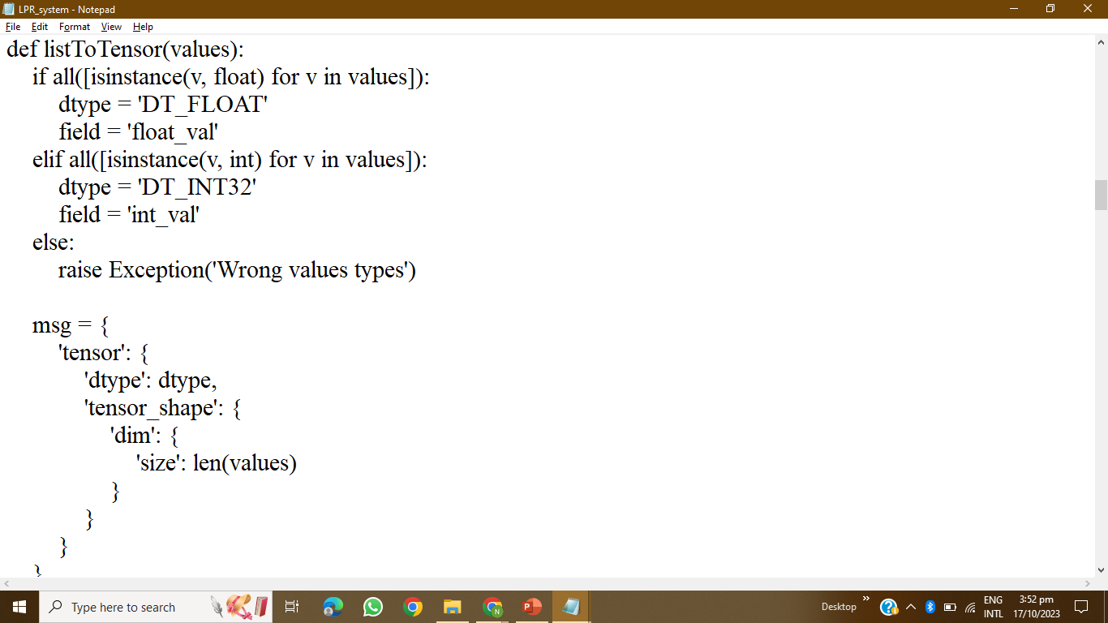
CODING

Slide 16
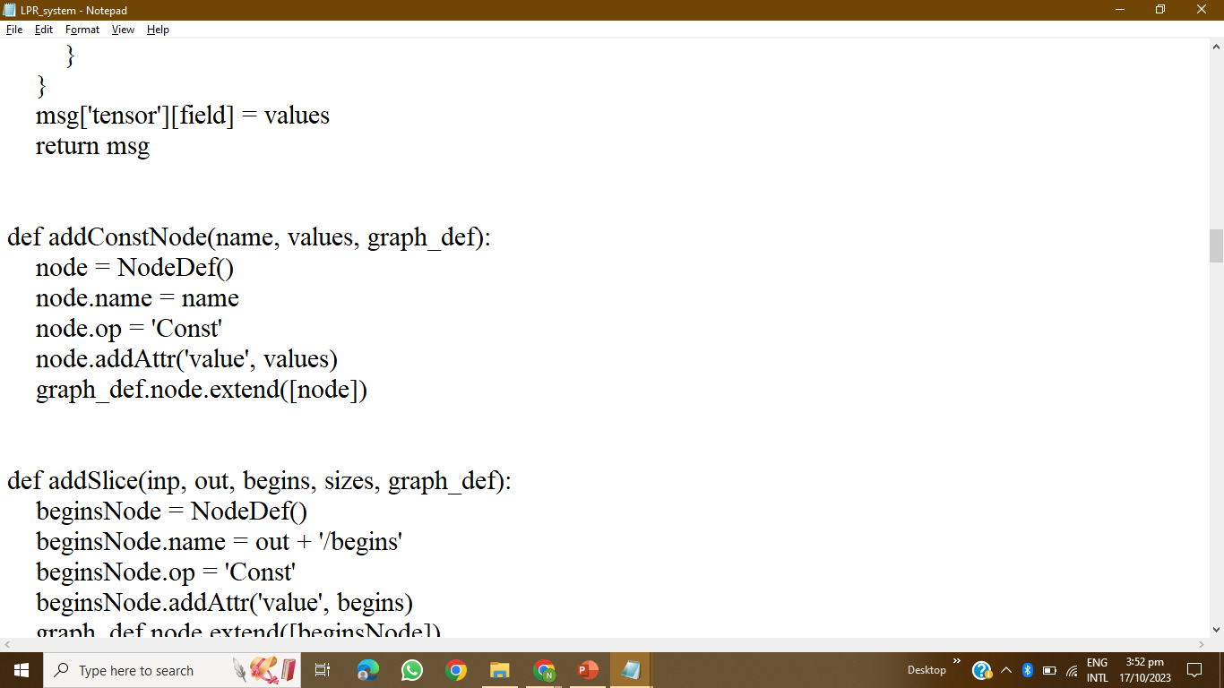
CODING

Slide 17
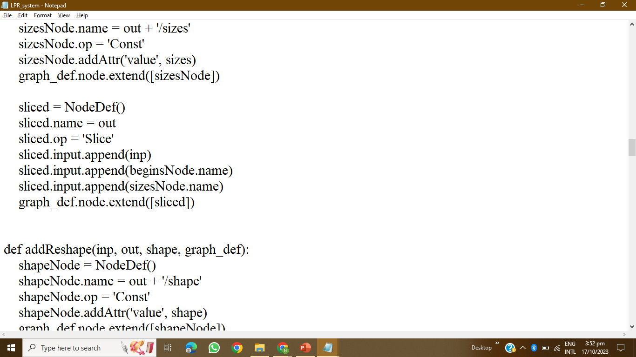
CODING

Slide 18
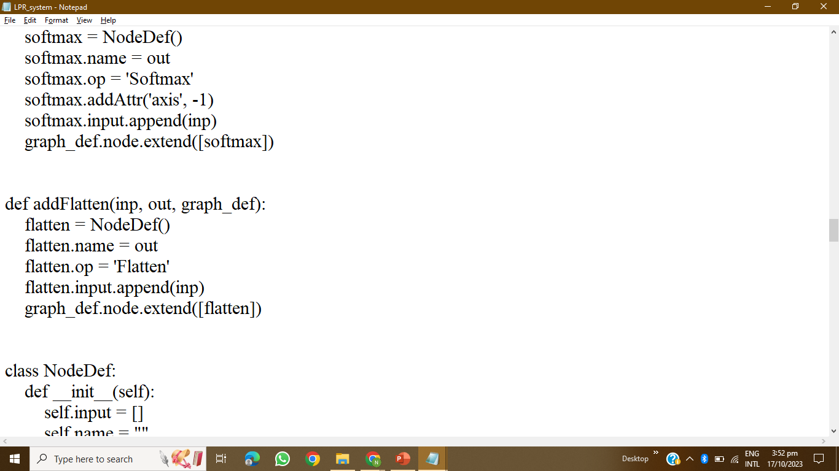
CODING

Slide 19
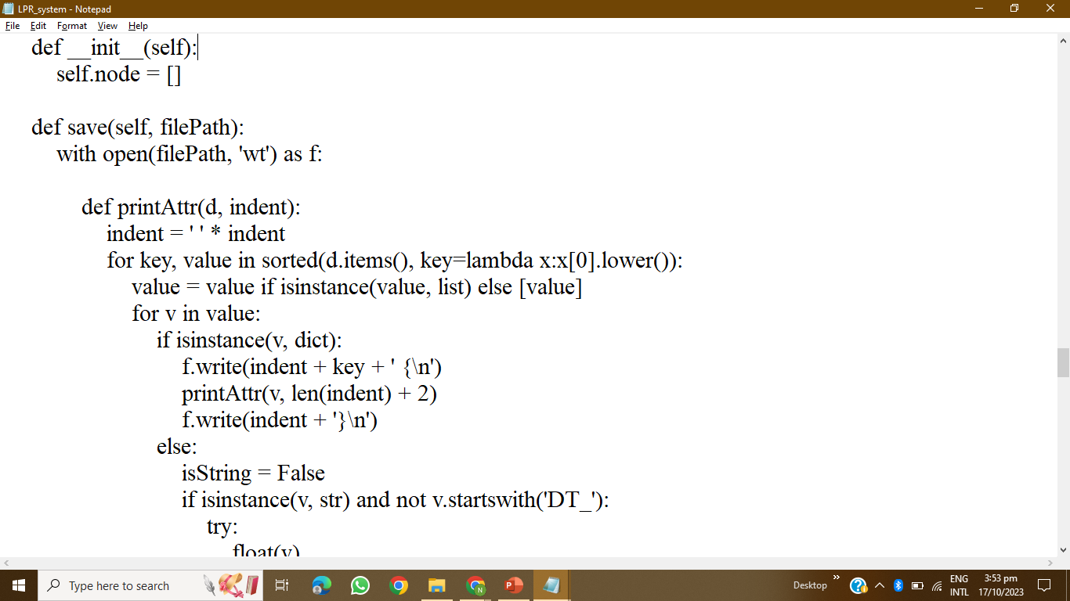
CODING

Slide 20
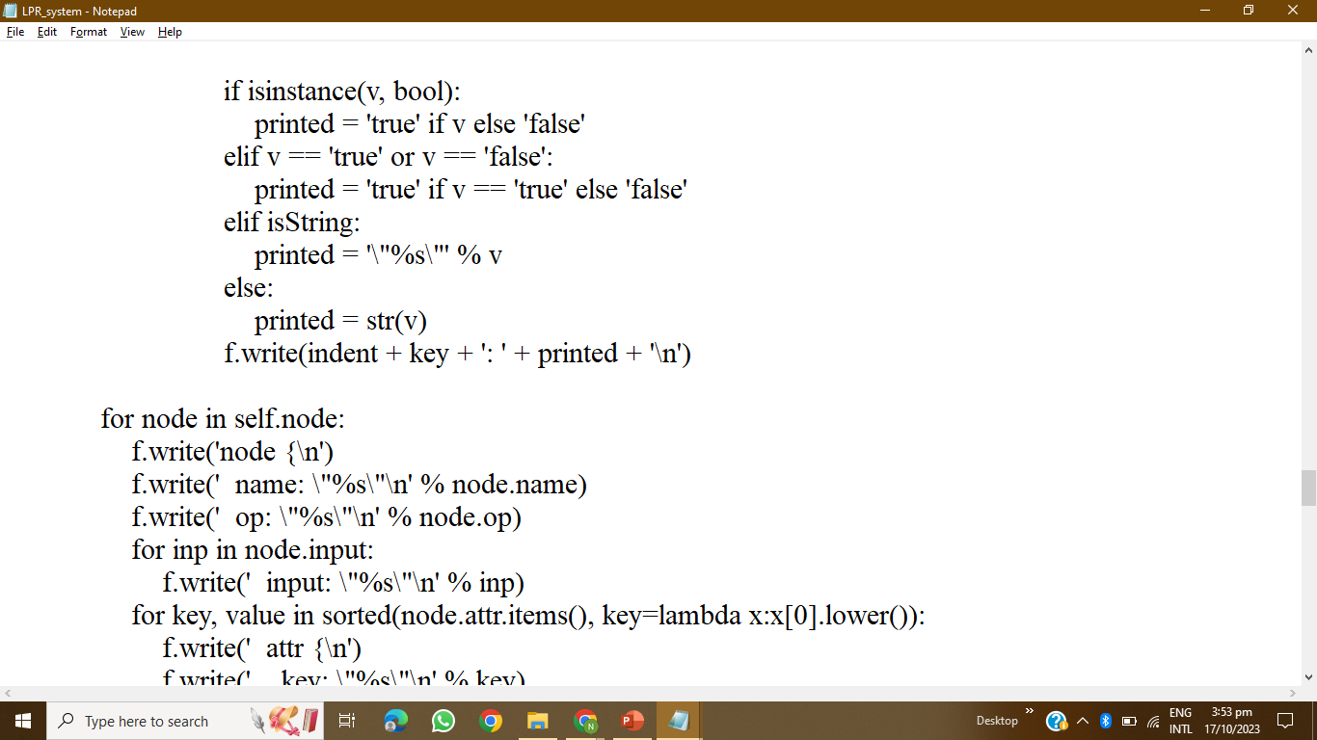
CODING

Slide 21
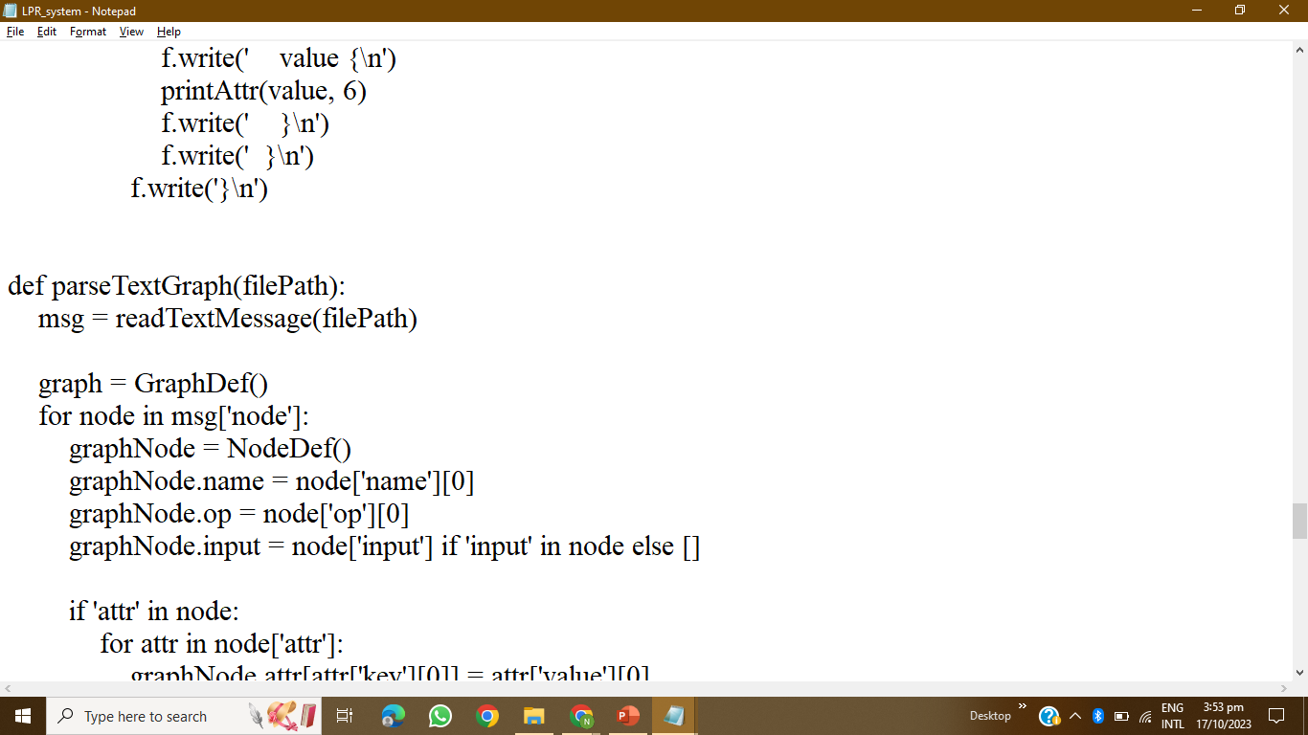
CODING

Slide 22
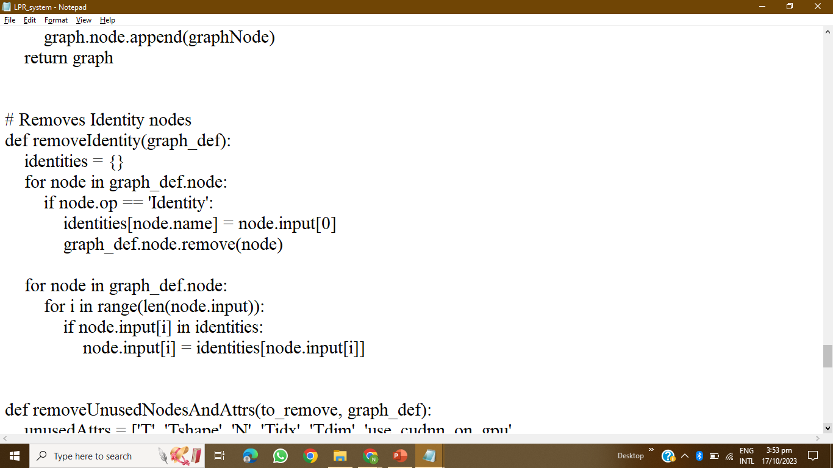
CODING

Slide 23
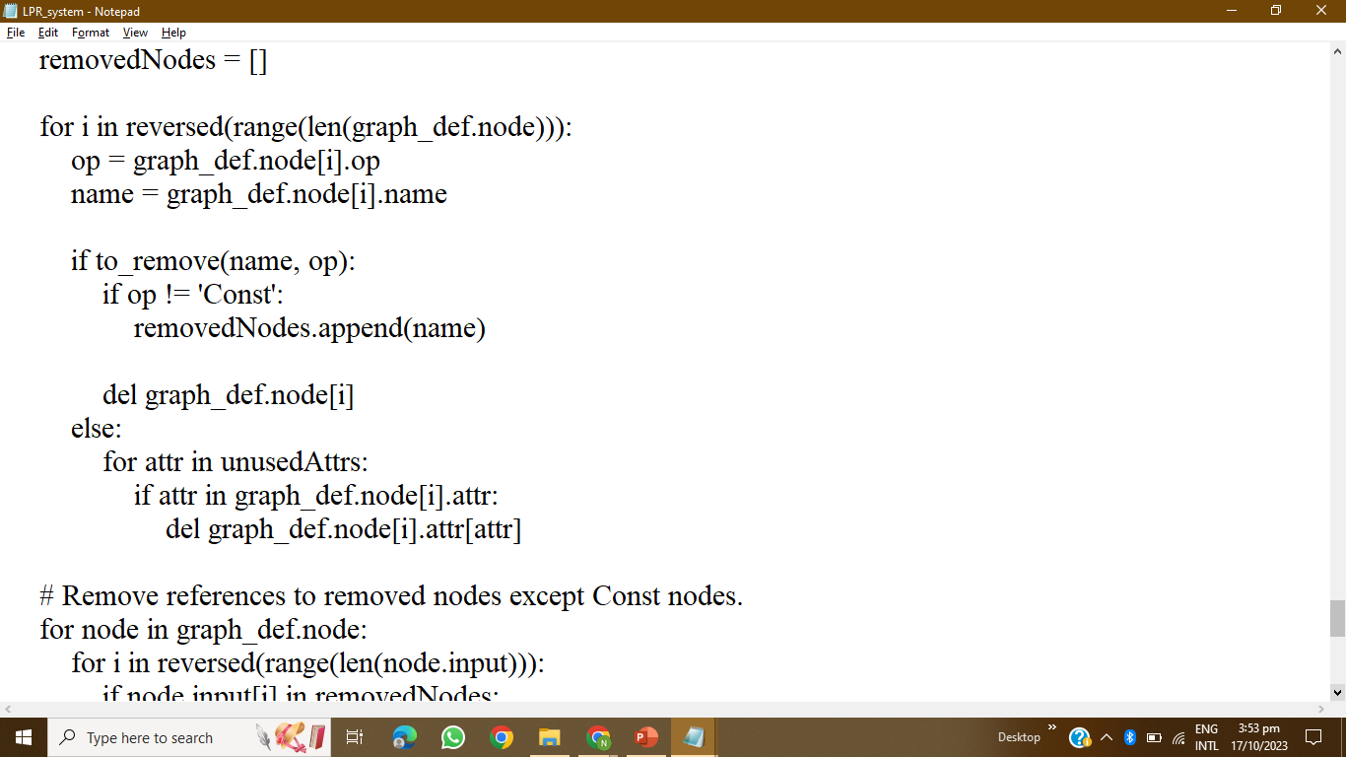
CODING

Slide 24
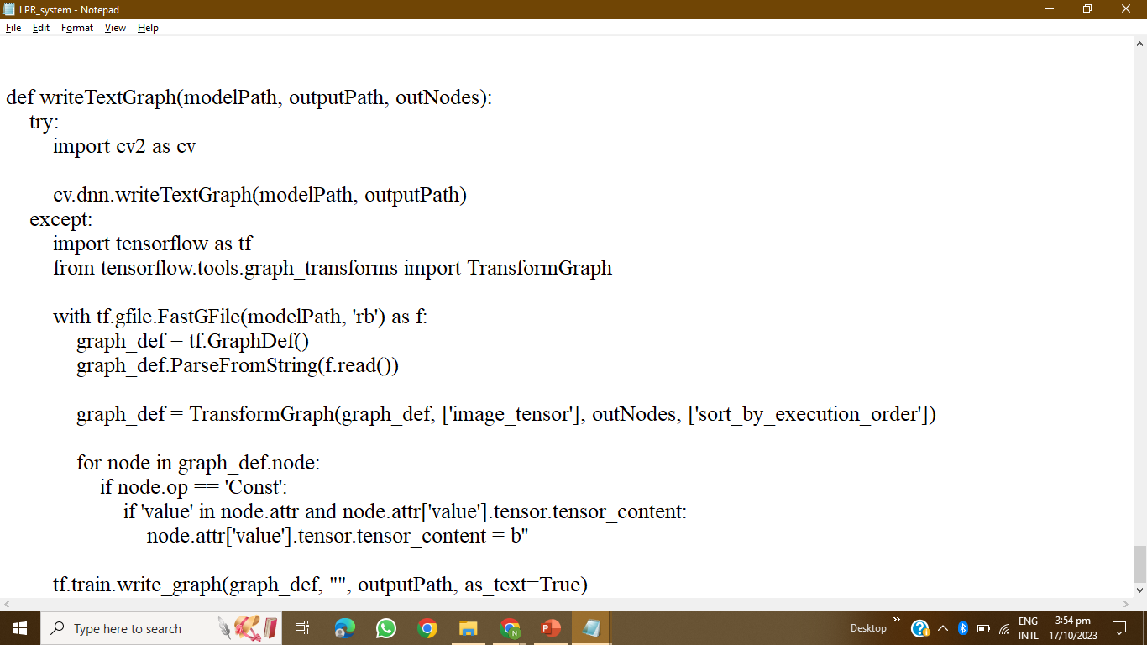
CODING

Slide 25
02
AUTOMATIC PARKING

Slide 26
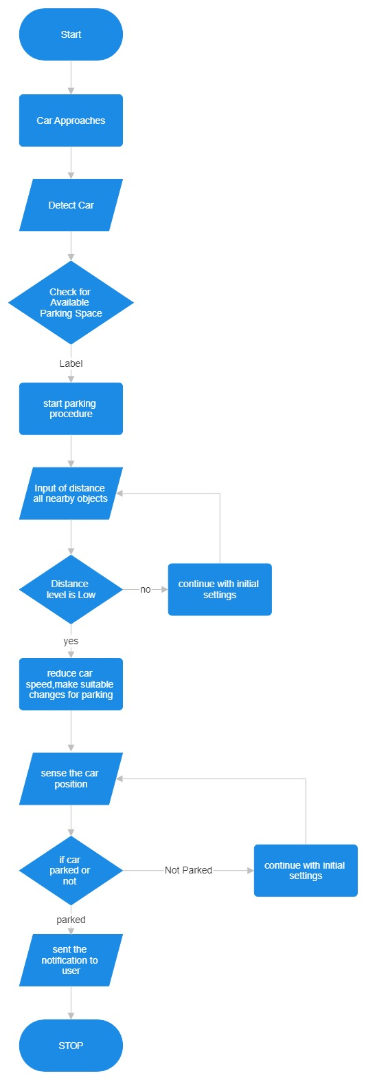
WORKING FLOW CHART

Slide 27
Vehicle Detection
When a driver arrives at a location equipped with automatic car parking, the vehicle's sensors and cameras scan the surroundings to detect obstacles, other vehicles, and available parking spaces
Mapping and Path Planning
The onboard computer system creates a map of the parking area and identifies suitable parking spaces based on the vehicle's size and the available spaces. It also plans the optimal path to the selected parking spot.
Vehicle Control
The car's autonomous driving system takes control of acceleration, steering, braking, and other necessary functions to safely navigate the vehicle to the chosen parking space. It uses real-time sensor data to make adjustments and avoid obstacles.
Parking Manoeuvres
The vehicle performs precise manoeuvres, including parallel parking, perpendicular parking, or diagonal parking, depending on the available parking space and the driver's preferences.

Slide 28
Monitoring and Safety
Throughout the parking process, the system continuously monitors the vehicle's surroundings, detecting any unexpected obstacles or changes in the environment. It can halt the parking process if necessary to ensure safety.
Parking Completion
Once the vehicle reaches the desired parking spot, it stops, aligns itself properly within the space, and engages the parking brake

Slide 29
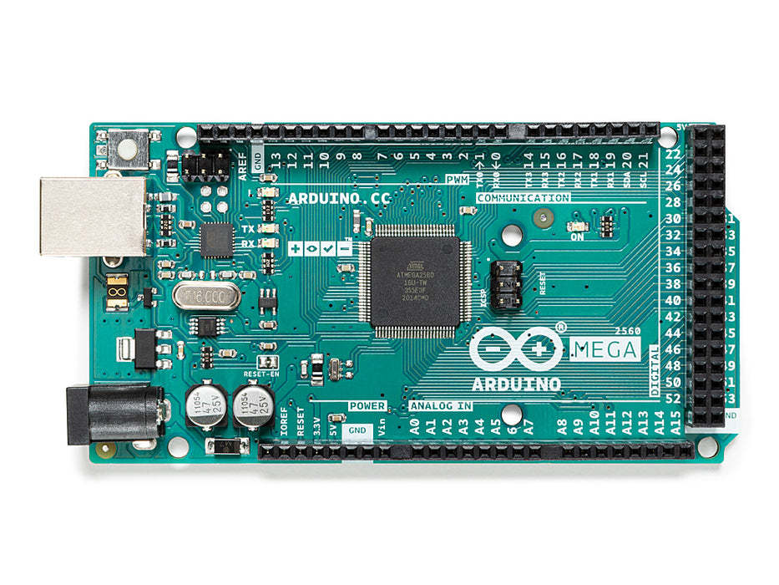
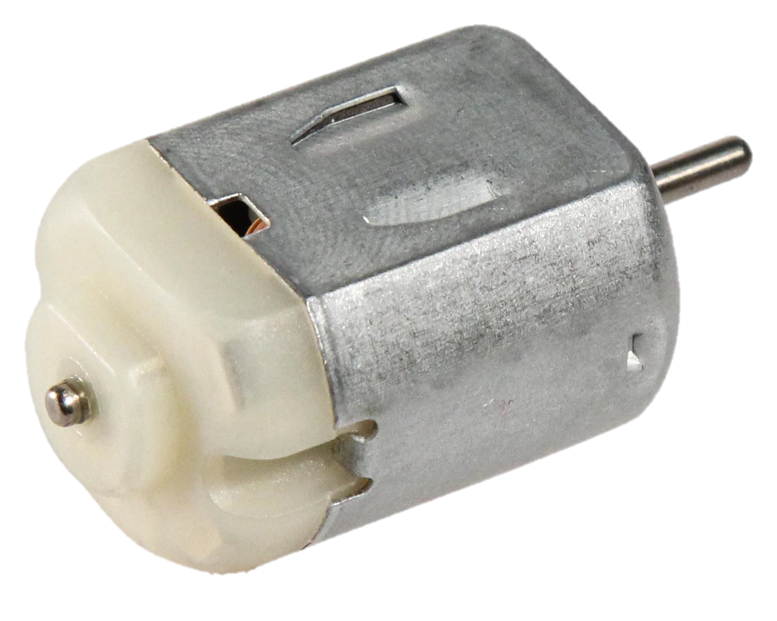
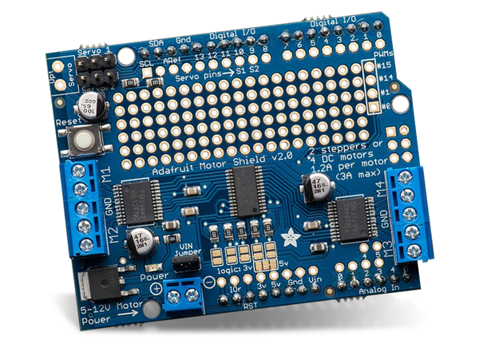
Components
Arduino Mega
ULTRASONIC SENSOR
Dc Motor
Adafruit Motor Shield

Slide 30
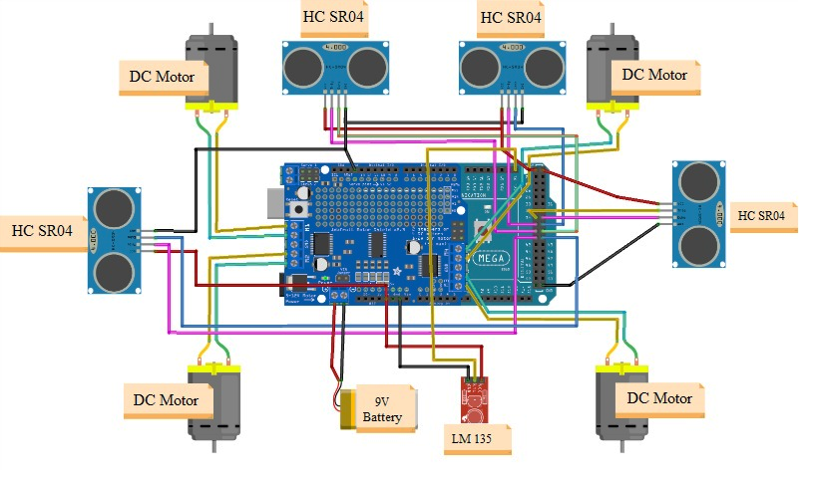
CIRCUIT DIAGRAM

Slide 31
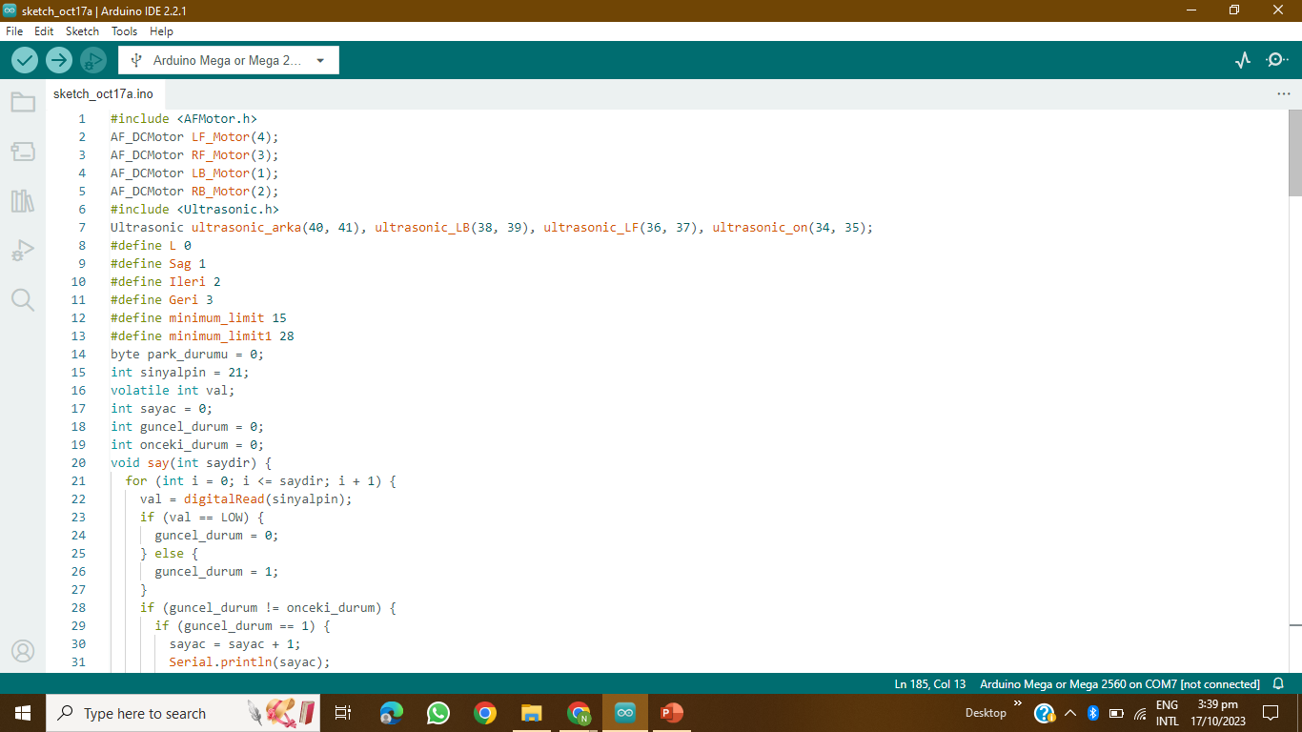
CODING

Slide 32
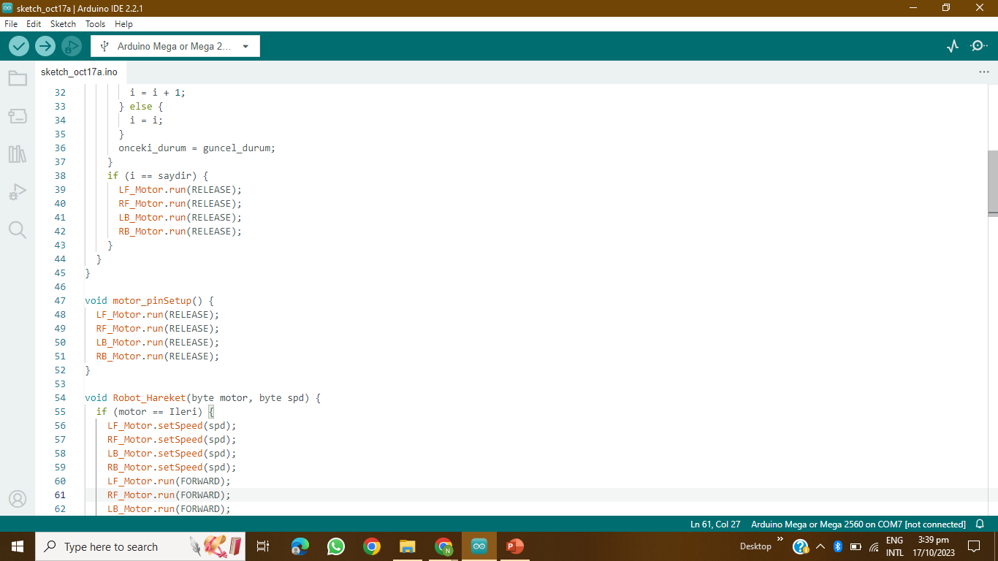
CODING

Slide 33
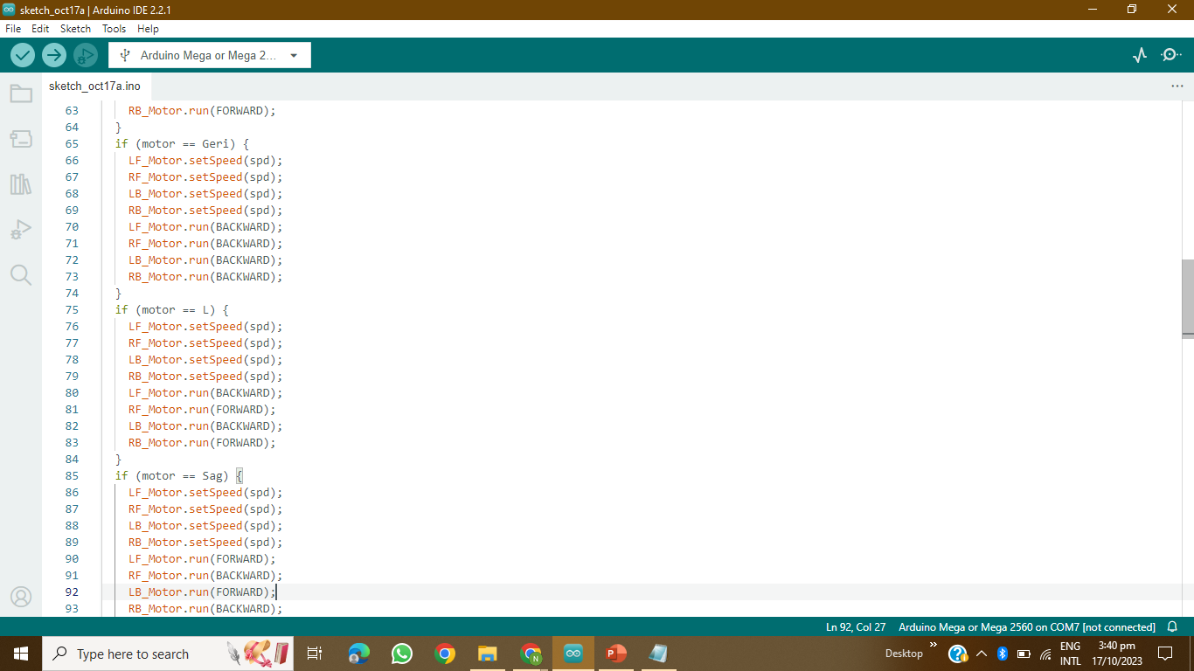
CODING

Slide 34
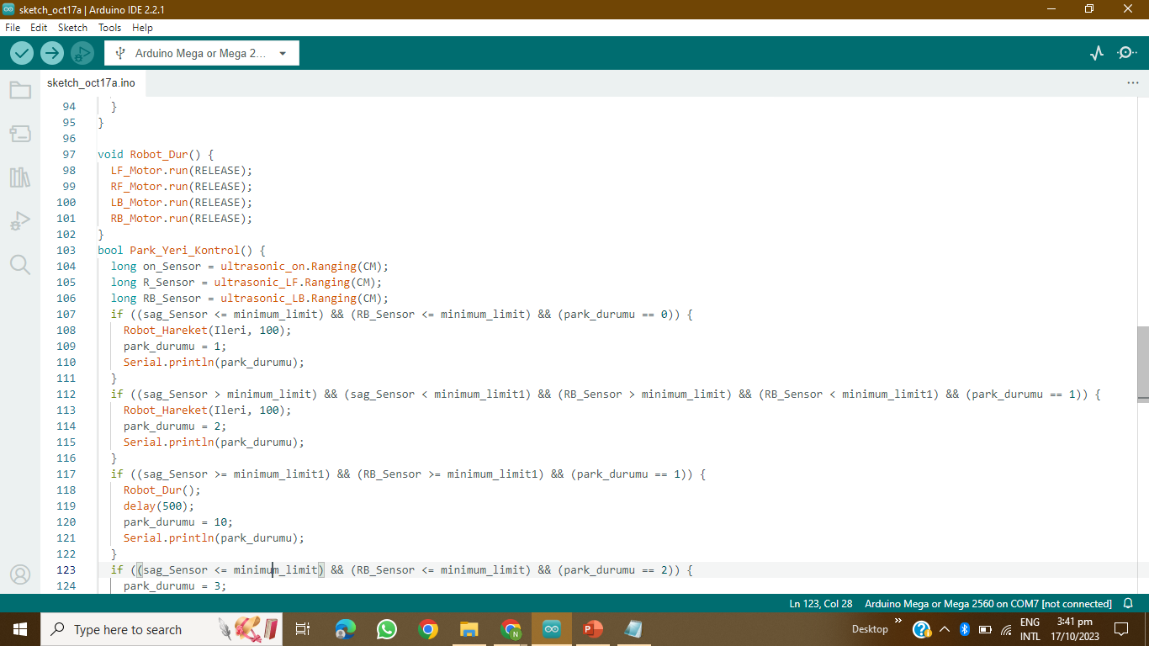
CODING

Slide 35
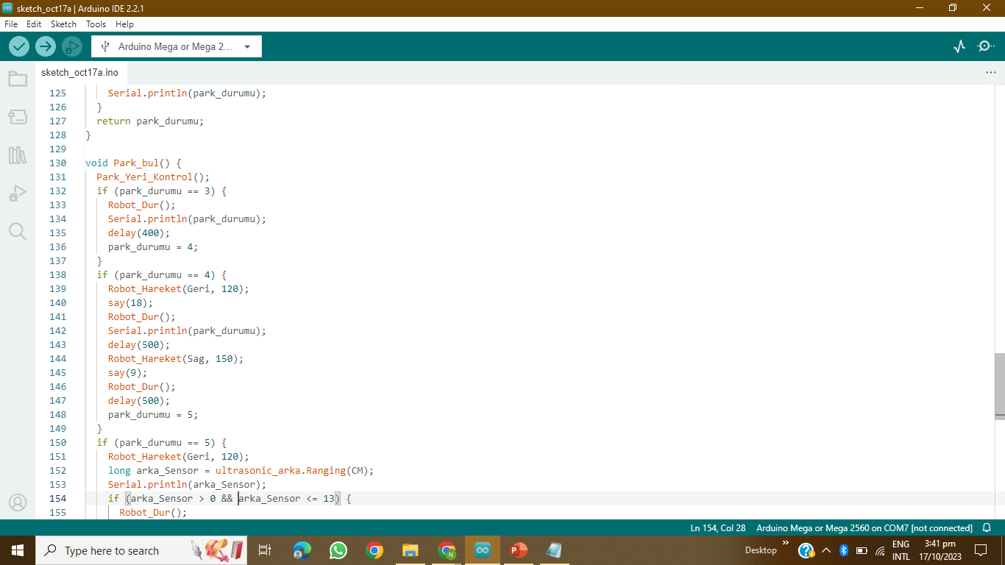
CODING

Slide 36
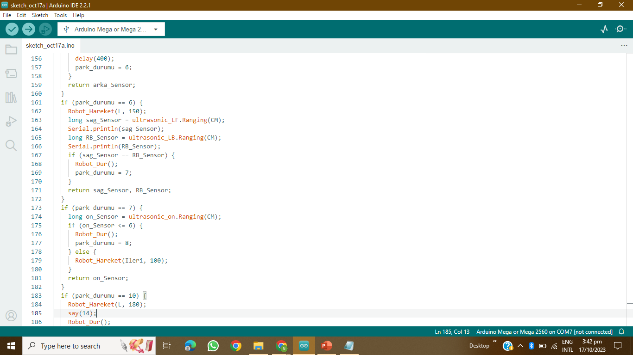
CODING

Slide 37
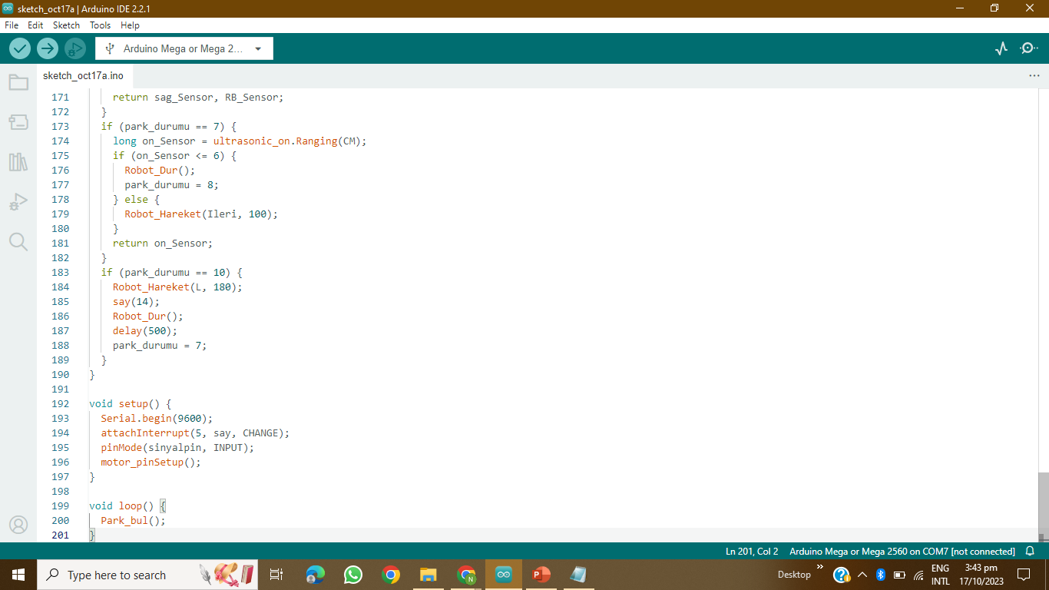
CODING

Slide 38
03
BLYNK

Slide 39

Introduction
Blynk is a user-friendly Internet of Things (IoT) platform that simplifies the development of IoT projects for both experienced developers and hobbyists. It offers a drag-and-drop interface, enabling users to create customized mobile applications to control and monitor connected hardware without the need for extensive programming or hardware expertise. Blynk is compatible with a wide array of hardware platforms, including Arduino, Raspberry Pi, and ESP8266, allowing users to connect their devices to the Blynk cloud and develop intuitive and interactive mobile apps for device control and data visualization. The platform provides various widgets such as buttons and sliders to facilitate interaction with IoT devices. Blynk's ease of use and strong community support have made it a popular choice among IoT enthusiasts, enabling them to rapidly prototype and deploy IoT applications with minimal learning curve.

Slide 40
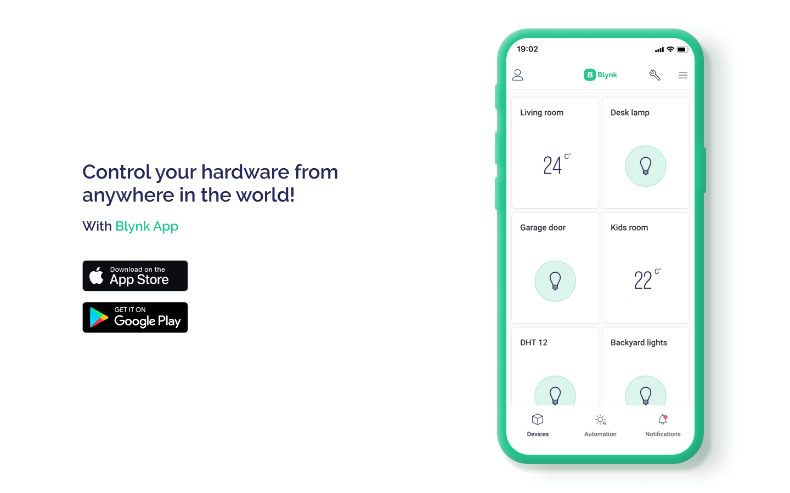
BLYNK

Slide 41
FLOW CHART
BLYNK
ESP32 Module
Arduino Mega

Slide 42
FLOW FLOW
This project aims to create a Smart Parking Management System that utilizes an ESP32-CAM module to monitor and relay real-time information about available parking spaces in a designated area to a Blynk app. Additionally, the system includes an autonomous parking rover constructed using an Arduino Mega, which can receive this parking information from Blynk and navigate to an available parking space independently.

